Slide 1
MICROPOLLUTANTS
BY:
Sebastián Gómez c.c 8062798
Lady Montoya Henao c.c 1038407403

Slide 2
INTRODUCTION
The major source of water pollution are sewage emissions, with potential pollutants including chemicals. Measures taken to prevent water pollution have made the presence of some of these decreases in water sources.
But the number of hazardous chemicals that can reach the environment is very broad, and there are some as micropollutants. It has been shown that these compounds are persistent, toxic, ubiquitous and have been detected in wastewater treatment plants, surface water and groundwater. Therefore it is necessary to identify and control these particularly dangerous pollutants.

Slide 3
WHAT ARE MICROPOLLUTANTS?
Organic or inorganic substances due to their toxicity, persistence and bioaccumulation may induce a negative effect on living and / or environmental ones.
These are natural or synthetic substances that are found in low concentrations (of the order of mg / L or ng / l, which are not removed by secondary treatment plant treatment) and having difficulties for analytical determination.

Slide 4
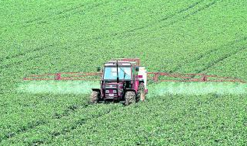
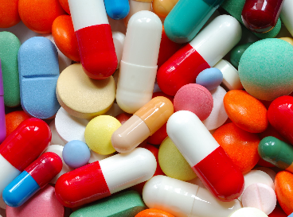
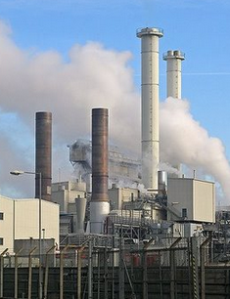
¿WHAT IS THE ORIGIN OF MICROPOLLUTANTS?
The presence of these compounds is primarily due to the following activities:
Agricultural practices (use of pesticides, fertilizers, etc...).
Origin and urban solid waste landfills (pharmaceutical products, personal care, etc.)
Activities of the industrial sector, in which a large number of organic compounds (solvents, degreasers, pigments, preservatives, cleaning agents, etc...) Are used.

Slide 5
BEGINS TO OBSERVE ITS INFLUENCE ON THE ENVIRONMENT:
Genetic mutations in fish and seabirds
Tumors and lesions in fish
Presence of fertilizers in the water
Changing water characteristics (odor, taste, color, turbidity, etc.)
Some of these micropollutants when they have their degradation may lead to the formation of "breakdown products" whose toxicity can be greater, equal or smaller than the original compound.

Slide 6
DETERMINE HOW?
Its control is performed by gas chromatography techniques and infrared. For the determination of trihalomethanes and pesticides the gas chromatograph is used with electron capture detector, nitrogen-phosphorus and flame. For the determination of phenols and polycyclic aromatic hydrocarbons and investigation of unknown substances present in the water a gas chromatograph is used with mass detector. The determination of dissolved or emulsified hydrocarbons is performed by an infrared spectrophotometer.

Slide 7
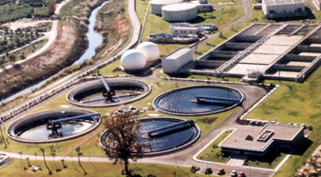
EFFECTS OF MICROPOLLUTANTS IN WASTEWATER TREATMENT

Slide 8
EMERGING CONTAMINANTS?
Micropollutants are emerging pollutants, this implies that chemicals or materials are characterized by a perceived or real threat , potential for human health and other living things in small concentrations , and the lack of the regulations.

Slide 9
ENDOCRINE DISRUPTORS
. Chemicals supplant natural hormones, disrupting the normal processes of reproduction and development
The distruptores found in cosmetics, shampoos, plastics, as well as preservatives and pesticides. These are released into the environment as a result of different manufacturing processes and the use of some consumer products.

Slide 10
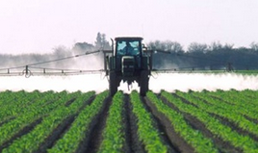

Slide 11
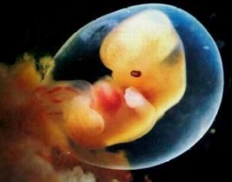
IN THEIR EFFECTS INCLUDE:
Cancers in male and female reproductive organs.
Malformations of fallopian tubes, uterus and cervix.
Masculinization of females and feminization of males.
Alterations of bone density and structure.
Some inhibit or alter the growth of bacteria, mold and mildew.
Abnormal hormone levels in blood.
Reduced fertility.
Altered sexual behavior.
Modification of the immune system.
No testicular descent.

Slide 12
TREATMENT OF MICROPOLLUTANTS

Slide 13
Processes that affect them:
BIODEGRADATION:
Due to the metabolic activity of the microorganisms.
Degradation rates depend heavily on the redox state (Scott and Morgan, 1990).
Some show micropollutants degradation only under a particular redox state. (Barbieri et al, 2011; Grünheid et al, 2005)
ADSORPTION
Mass transfer of dissolved species to a solid surface. The microcontaminantes orgánicos show great variability in their behavior. Tend to adsorb on non-polar organic matter, the cationic and anionic surfaces respectively negatively and positively charged.

Slide 14
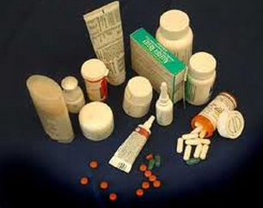
PHARMACEUTICALS AND COSMETICS AS CONTAMINANTS (PPCPs)
Cosmetics and Pharmaceutical Compounds are a diverse group of chemicals that include human and veterinary drugs, hormones and other products used in the formulation of cosmetics. These substances deserve special attention because of the possible adverse effect resulting from the fact that the associated compounds such biological effects may be extended to organisms living in the various environmental compartments affected by discharges

Slide 15
CONCLUSIONS
Today micropollutants are still ignored and they are not monitored. Its adverse effects on living organisms have been reported in various studies, and this has encouraged the study of these contaminants and potential removal options with new systems of wastewater treatment . Of the different treatment that have been implemented so far, are activated carbon and membranes which have proven to be the most efficient.
So are several studies that show the great potential of advanced systems for the removal of emerging contaminants, which are mainly used as a pre and / or post treatment for water with higher biodegradability, but economic issues limited their application.

Slide 16
LITERATURE
http://www.quimicaviva.qb.fcen.uba.ar/v10n2/garcia.html
http://www.ingenieria.unam.mx/~revistafi/ejemplares/V14N2/V14N2_art11.pdf
http://www.h2ogeo.upc.es/seminarios/2012/Seminario%20Cristina%20Valhondo.pdf
http://www.degremont.es/es/images/pdf/microcontaminantes-%20degrmont-%20aeas%202013.pdf

